Slide 1
Final Project Proposal: 8 Ball Pool
Class: ICS3U1
By: Matthew, Daniel and Elgin
Last Updated: January 11, 2016
Date Started: December 16, 2015
Date Delivered: To be determined

Slide 2
Customer Requirements
Our clients are the teacher and the students in our class.
- A cue that is controlled by the mouse.
- The orientation (or direction) of the cue will be determined by the location of the mouse.
- When the left button on the mouse is clicked and dragged, the cue will move backwards. When the left mouse button is released, the cue will collide with the cue ball and transfer speed and direction values to the ball depending on how far the cue was pulled back as well as it’s orientation.
- Once the cue ball is moving, it will collide with other balls in it’s direct line and will in turn transfer the appropriate speed and direction values to the other balls depending on the impact location and prior speed of the cue ball. These rules will apply to any subsequent collision between any other balls on the pool table.
- if any ball falls into a pocket or is “pocketed”, then the ball will be removed from the playing surface and the appropriate score/game scenario will be recorded.
- The game will operate in accordance to the 8 ball pool format. After the initial break by one player, the first ball pocketed will determine which player is assigned to solid or striped balls. If a player pockets the black ball (“8 ball”) is pocketed at any time, the other will win the game. The first player to pocket all balls of the type they are assigned to, and then pocket the 8 ball last will win the game.

Slide 3
Project Timeline
 | Requirements | Design | Implementation | Testing | Deployment
Proposed | Dec 15-18 | Jan 4-8 | Jan 9-16 | Jan 17-19 | Jan 20-33
Completed | Dec 18-Jan 4 | Jan 4-11 | Jan 11-24 | Jan 20-24 | Jan 25

Slide 4
Design Proposal
The game will consist of a cue that the players will control with their mouse, and use varying direction and amount of force in order to move a cue ball which will strike other balls in order to pocket them. The end goal is to pocket all of the balls assigned to the player, with the final ball being the black, or cue ball.
The physics and game play elements (such as dragging the cue and the physics of the ball movements) will be original.
In addition the menu and other graphical elements will all be original work
The program will use libraries such as “math” or “sin”
Resources:
https://www.pygame.org/docs (used as a reference to make sure function parameters and return values are in the correct positions.
http://www.purplemath.com/modules/distform.htm (distance formula)
http://stackoverflow.com/questions/10473930/how-do-i-find-the-angle-between-2-points-in-pygame (Find the angle between two given points)

Slide 5
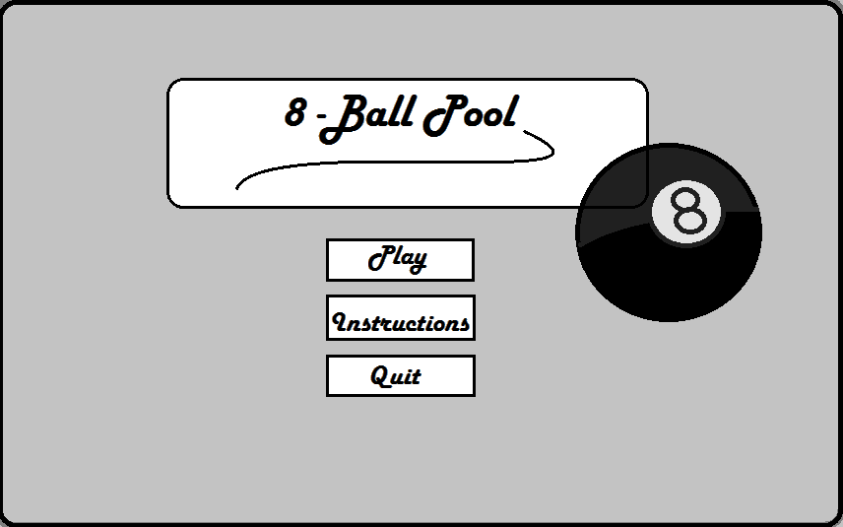
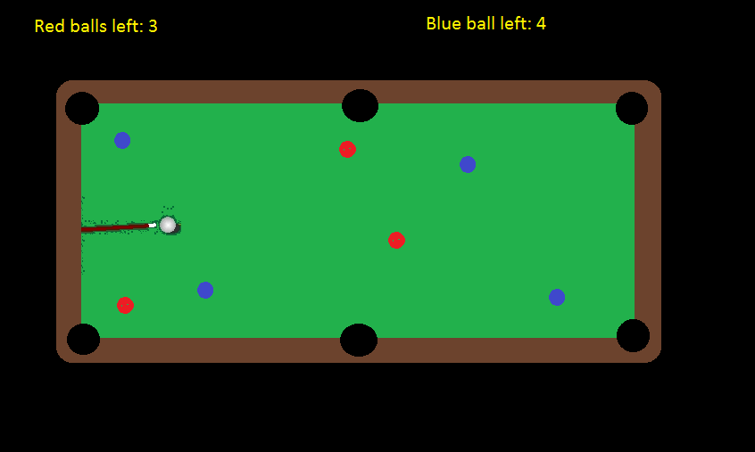
Design Proposal – Mockups
Main menu
Gameplay

Slide 6
Design Proposal – IPO Chart
Input | Process | Output
Menu Users Choices; Choice A – Start Playing Choice B – How To Play Choice C – Quit Game | Start Menu If Choice A: Play 1v1 by taking turns using the mouse If Choice B: A guide on how to play If Choice C: Quits Game | Position of each ball on the table Position and speed of the cue based on user input Direction and speed of each ball based on the initial strike by the cue, as well as any subsequent collisions with other objects on the playing surface. The current number of ball pocketed (score) and number of balls left to pocket per player

Slide 7
Design Proposal – Stepwise Refinement
move_cue()
Move_balls()
8 Ball Pool
main_menu()
display_score( )

Slide 8
Design Proposal - Flowcharts
Start
Menu ( )
Move ( )
move_cue ( )
move_balls ( )
Display ( )
display_score()
Stop

Slide 9
Menu ( )
Print (“Welcome to 8 Ball Pool”)
Print (“Play”)
Print (“Instructions”)
Print (“Quit Game”)
Display ( )
If Choice == (“Start Game”)
If Choice == (“Tutorial”)
pygame.quit ( )
Stop
Move ( )
Print (“All the instructions”)
Notes:
<number>

Slide 10
menu()
Print menu()
Get_user_choice()

Slide 11
move_cue()
Draw_pool_table()
Get_cue_position()
Draw_cue()

Slide 12
move_balls()
Get_ball_positions()
Draw_pool_table()
Get_ball_speed_and_direction()
Determine_if_ball_pocketed()
Draw_balls()

Slide 13
display_score()
determine_score()
draw_score()

Slide 14
Design Proposal - UML Diagrams
Ball
Int Speed Int Direction String Colour
move_ball()
Pocket()
Int location()
check_for_ball_contactl()

Slide 15
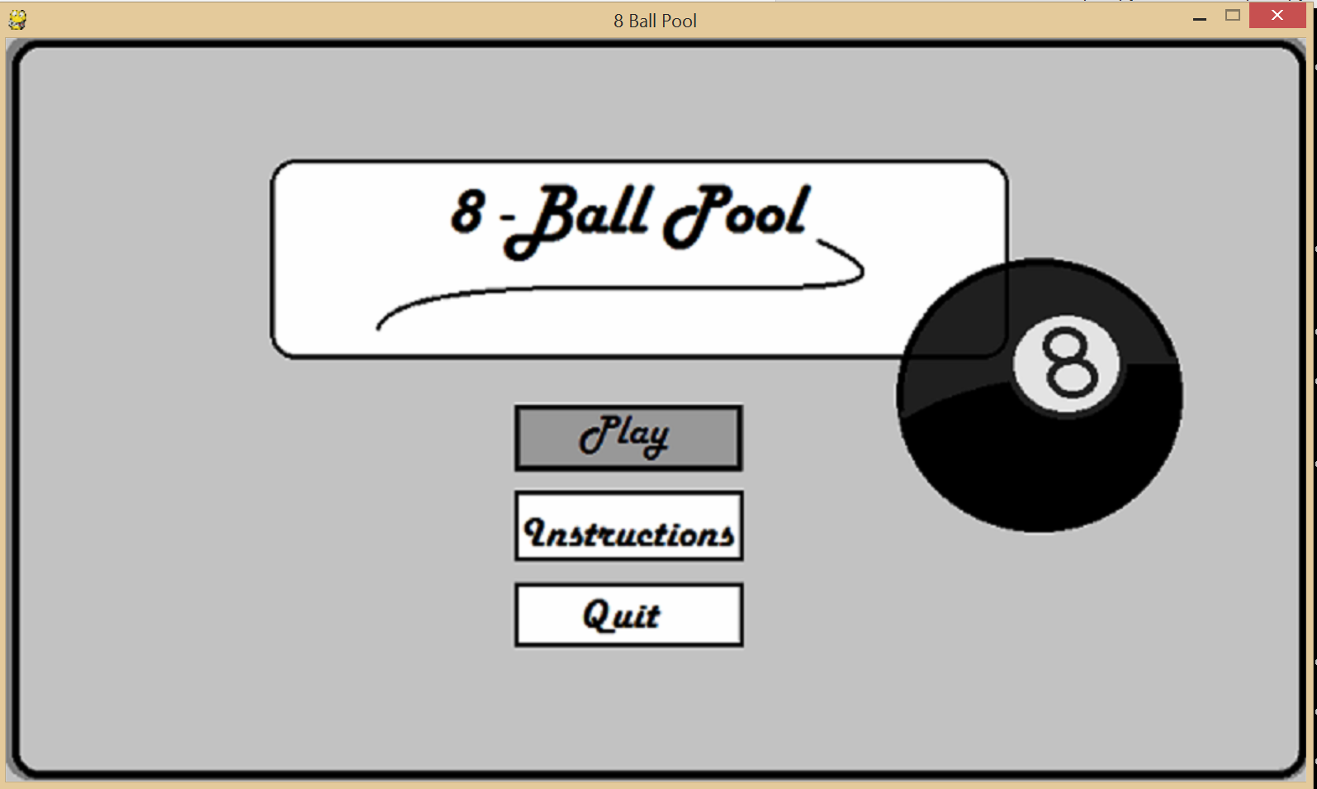
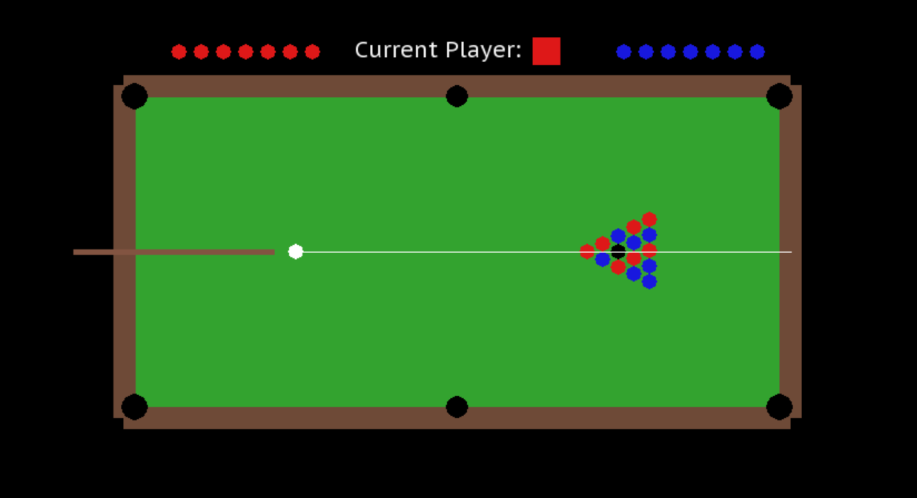
Implementation Details and Deliverables
Our game allows the user to play a game of billiards in a two-player format. It is meant to be a reasonably realistic simulation of the 'eight ball' game format.
For the game to operate correctly, every game file in the 'project files' folder must be present. In addition, Python 2.7+ and Pygame must be installed on the computer.
How the game works:
Classes were used to define what a ball was, and 15 instances of Ball() were created to represent each ball.
Functions were created to draw every visual element of the game, including menu screens and the playing surface.

Slide 16
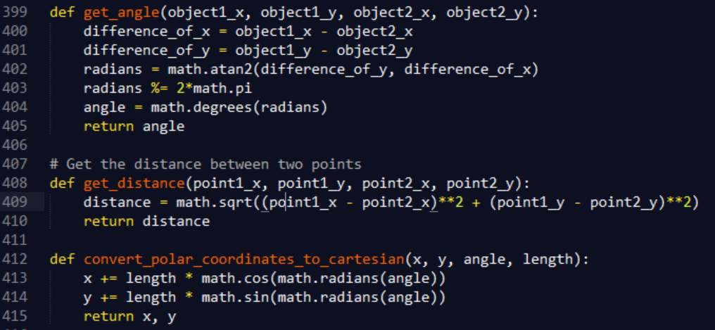
Implementation Details and Deliverables
Additional functions were created to track mouse location and use that to determine the angle of the cue.
In order to convert the location of the mouse and the cue ball into a usable angle, Matthew used this formula to determine the angle of the mouse at any given time.
In order to convert the angle of the mouse + the length of the cue, into a pair of Cartesian coordinates, Matthew used this formula to convert polar coordinates to Cartesian coordinates.

Slide 17
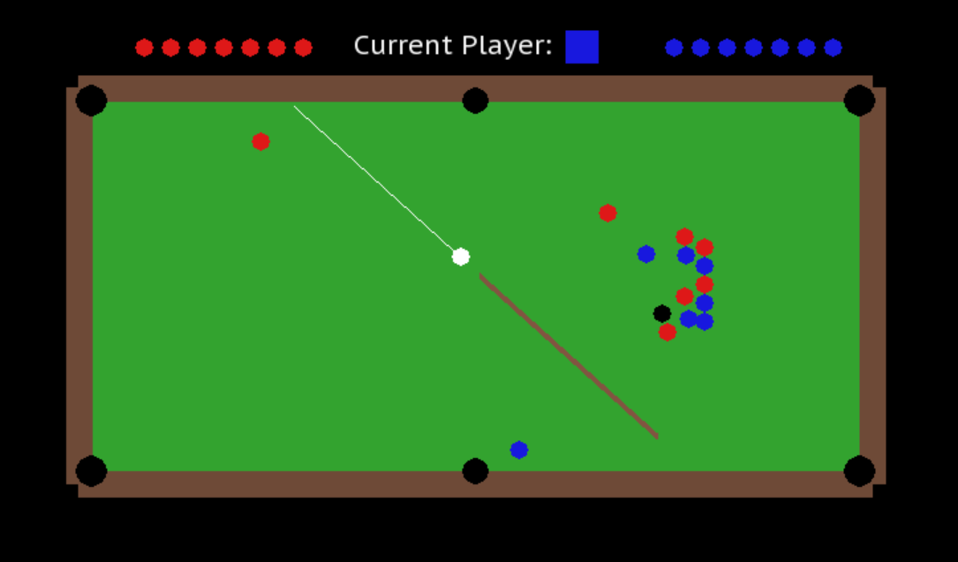
Implementation Details and Deliverables
Lastly, functions were also created to manage the direction, speed and current status of each ball on the pool table.
In order to calculate the resulting angles of balls after ball_to_ball() or ball_to_cushion() collisions, Matthew devised several formulas using trial and error. As a result, all possible collisions that a ball can encounter are reasonably accurate for the game.

Slide 18
Maintenance
As a whole, We believe that out project was a success. We created a game that was neatly at the edge of our ability, since it required complex physics and the ability to model the interactions of 15 billiard balls at the same time. Most of the time was used to make the ball collisions realistic. In contrast, drawing the pool table was relatively easy. We think that the realism of the speed and collisions of the game went well. We are also proud of the menus and screens we created to navigate through the game.
Areas that need more time and effort include the flow charts/planning aspect of the game. If the game were more meticulously planned, then programming the game might have taken much less time than it has. Another aspect of the game that we would like to imporve are the graphics. The game would look a lot more polished if the balls were “spinning” and if the pool table had a felt texture and wood grain on the perimeter.
The last area of need would be a few bugs present in the ball movement in the game. Sometimes the ball gets stuck to the wall, and that sometimes hinders the user's enjoyment of the game. Therefore, three things that we would improve, if given the oppurtunity, are the flowcharts, graphics and the ball simulation bugs.

Slide 19
Resource Allocation
Task | Responsibility | Description
Daniel | IPO Chart Flowcharts Proposal | Created an IPO Chart to use for making the flowchart Constructed a variety of flowcharts to use for creating the pygame Created Project Timeline Helped with integrating ideas into the game Found several bugs, which were later fixed.
Matthew | Writing the program Flowcharts UML Diagrams Final Proposal Final Report | Wrote the program (8_ball_pool.py) Helped with making flowcharts Created the required UML Diagrams Created design proposal Created Mockups Wrote the implementation details, maintenance and references reports.
Elgin | Step Wise refinement Menu screens Flowcharts | Created stepwise refinement Helped with design proposal Helped with flowcharts Helped with logic Designed the menu screens for the game Helped with game graphics

Slide 20
References
- Determine the angle between two Cartesian points: http://math.stackexchange.com/questions/1201337/finding-the-angle-between-two-points
- Convert polar coordinates to Cartesian coordinates: (https://www.mathsisfun.com/polar-cartesian-coordinates.html)
- Allowed the Ball() class to be iterable: http://stackoverflow.com/questions/739882/iterating-over-object-instances-of-a-given-class-in-python
- Font used: www.fontsquirrel.com/fonts/PT-Sans

